Slide 1
Analyzing Meteorological Variables and Precipitation Pattern in Amazon Rainforest
Chetan Gurung
Project 1
Data 601

Slide 2
Outline
Introduction
Objectives
Data Source
Discussions and Results
References

Slide 3
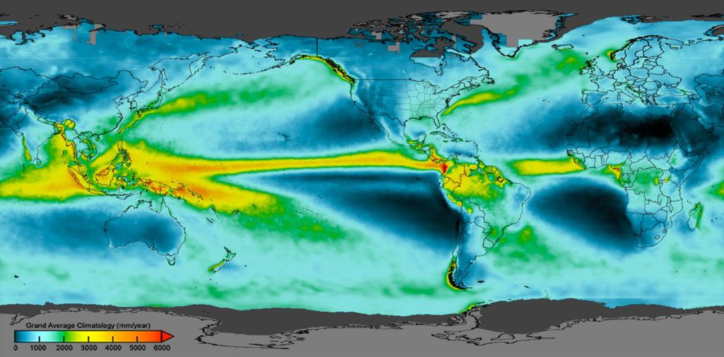
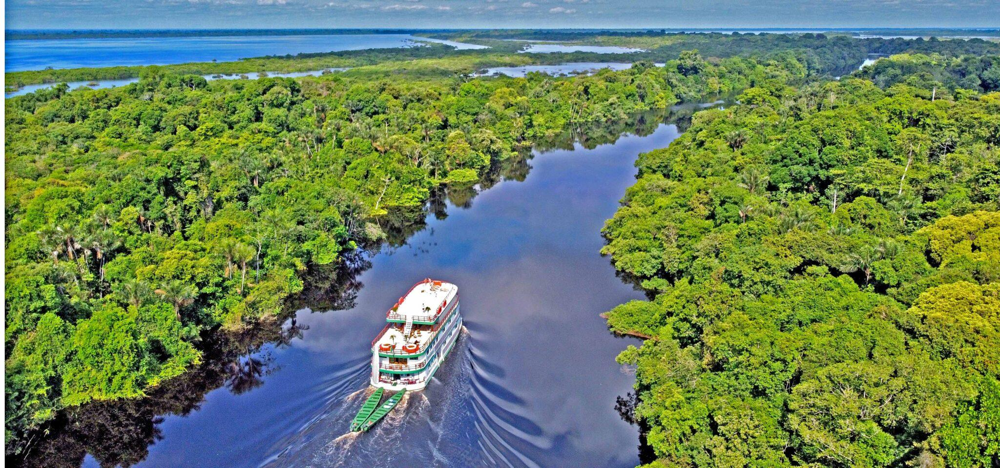

Amazon Rainforest
World largest rainforest (5.5 millions km^2)
Comprises the largest and most biodiversity.
World largest carbon sinks
Manaus, capital of the Amazonas state in Brazil.
A major departure point for the surrounding Amazon rainforest.
Famous for :
River Cruise
Jungle Tours
Global precipitation
Amazon rainforest
Notes:
Why Amazon rainforest?-rare obs in tropics. GoAmazon Campaign

Slide 4
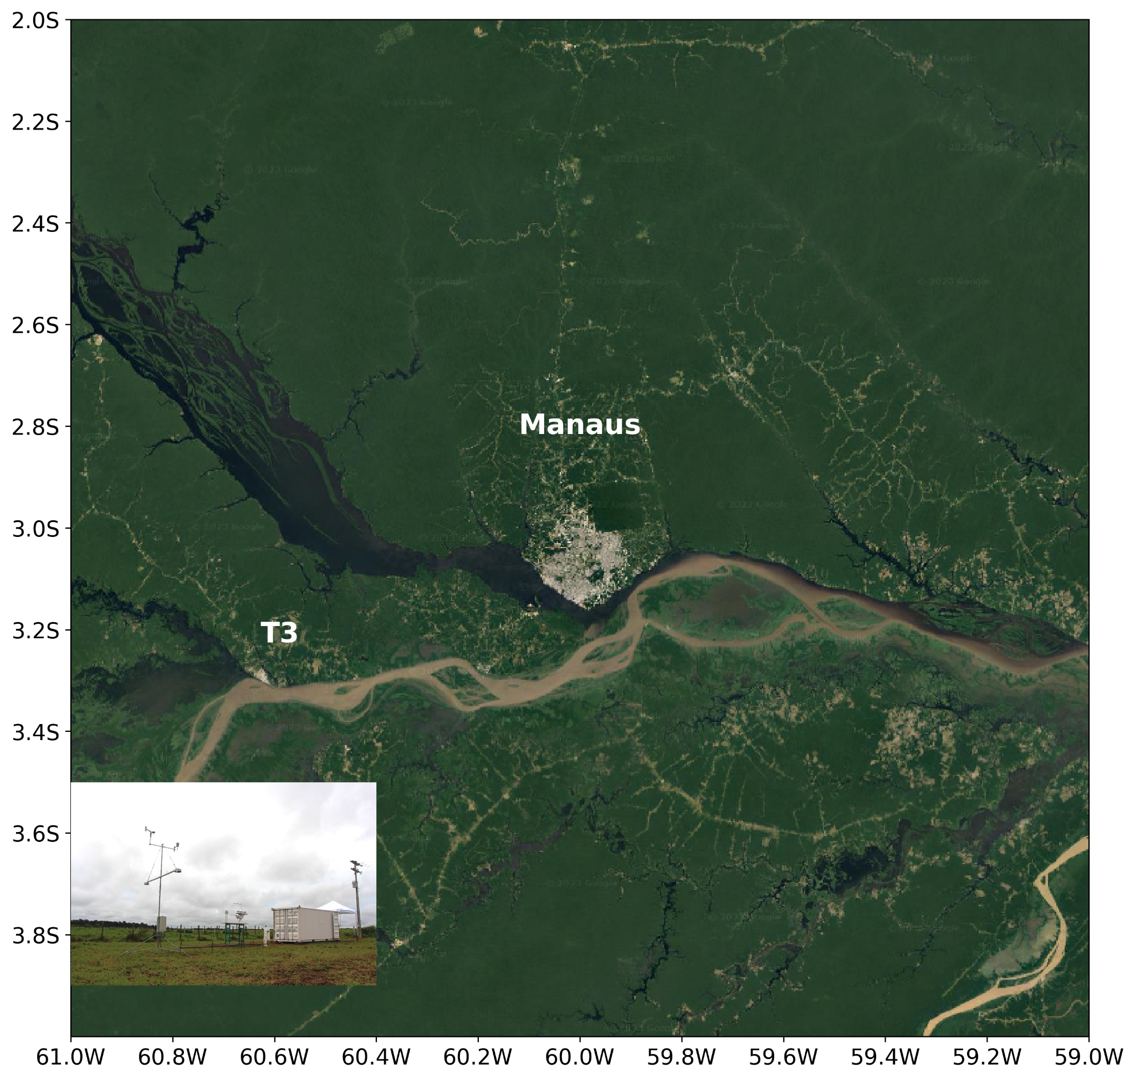
Source of Data
GoAmazon 2014/15 campaign, conducted by the ARM mobile facility.
https://adc.arm.gov/discovery/#/results/s::mao
Fig. Manaus and Manacapuru (T3) located at Amazon rainforest.
Objectives: Analyzing the weather of Amazon rainforest (Manaus)
Notes:
Although short period, rare such extensive observation in tropical region around the world.
Very advanced instruments.
Very helpful to study surface atmosphere interaction. Validation source for climate and weather model.

Slide 5
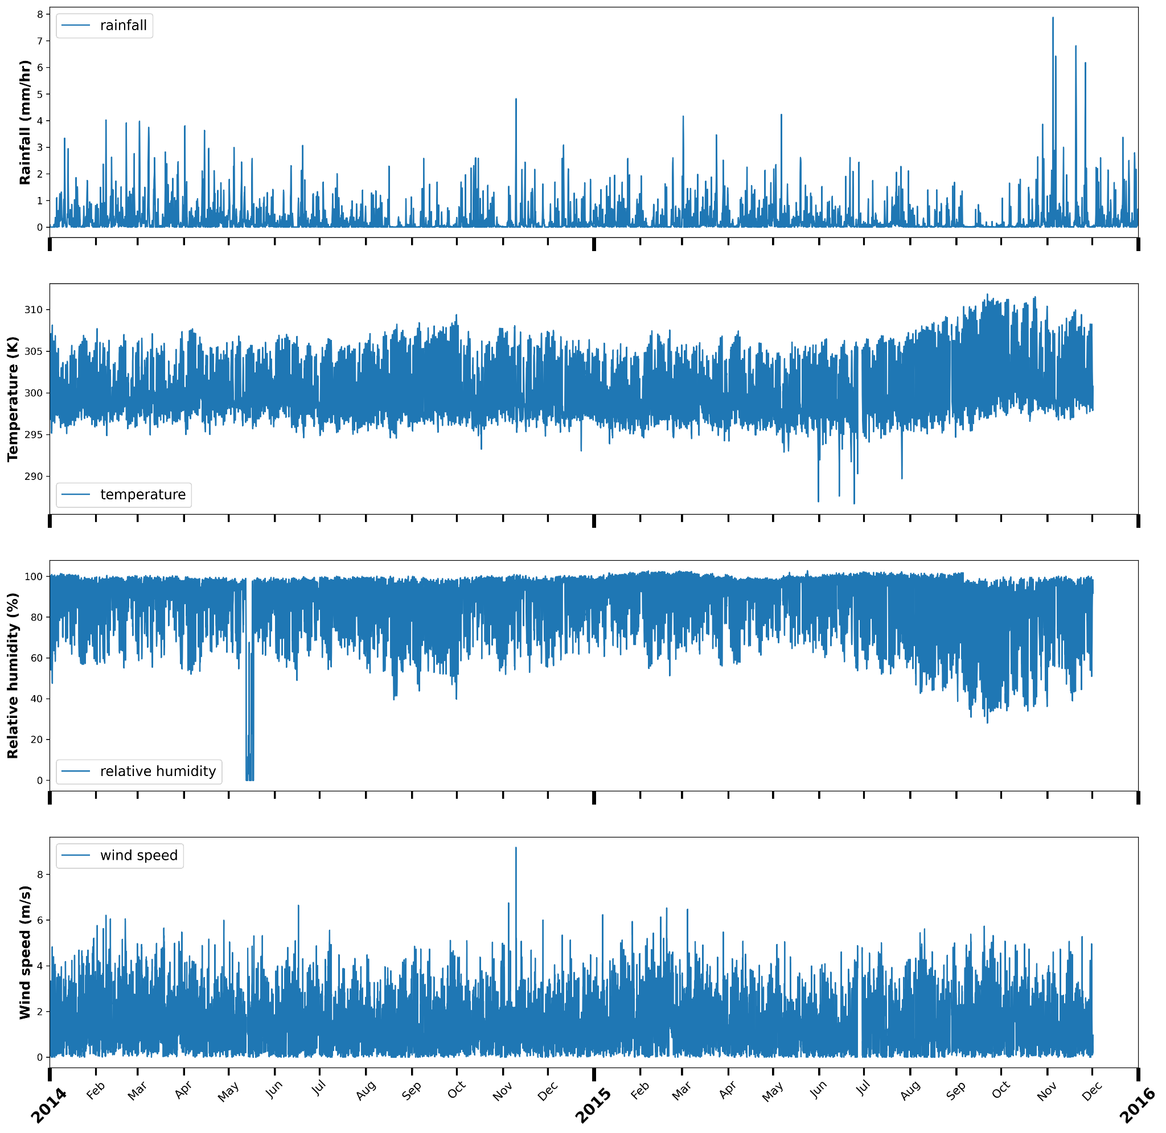
Discussions
Time Series Plots
High rainfall rate in the late months of 2015
( El Nino-2015??)
Hard to analyze the plots.
Fig: Time series plot from top to bottom: rainfall, temperature, relative humidity, and wind speed at Manaus.

Slide 6
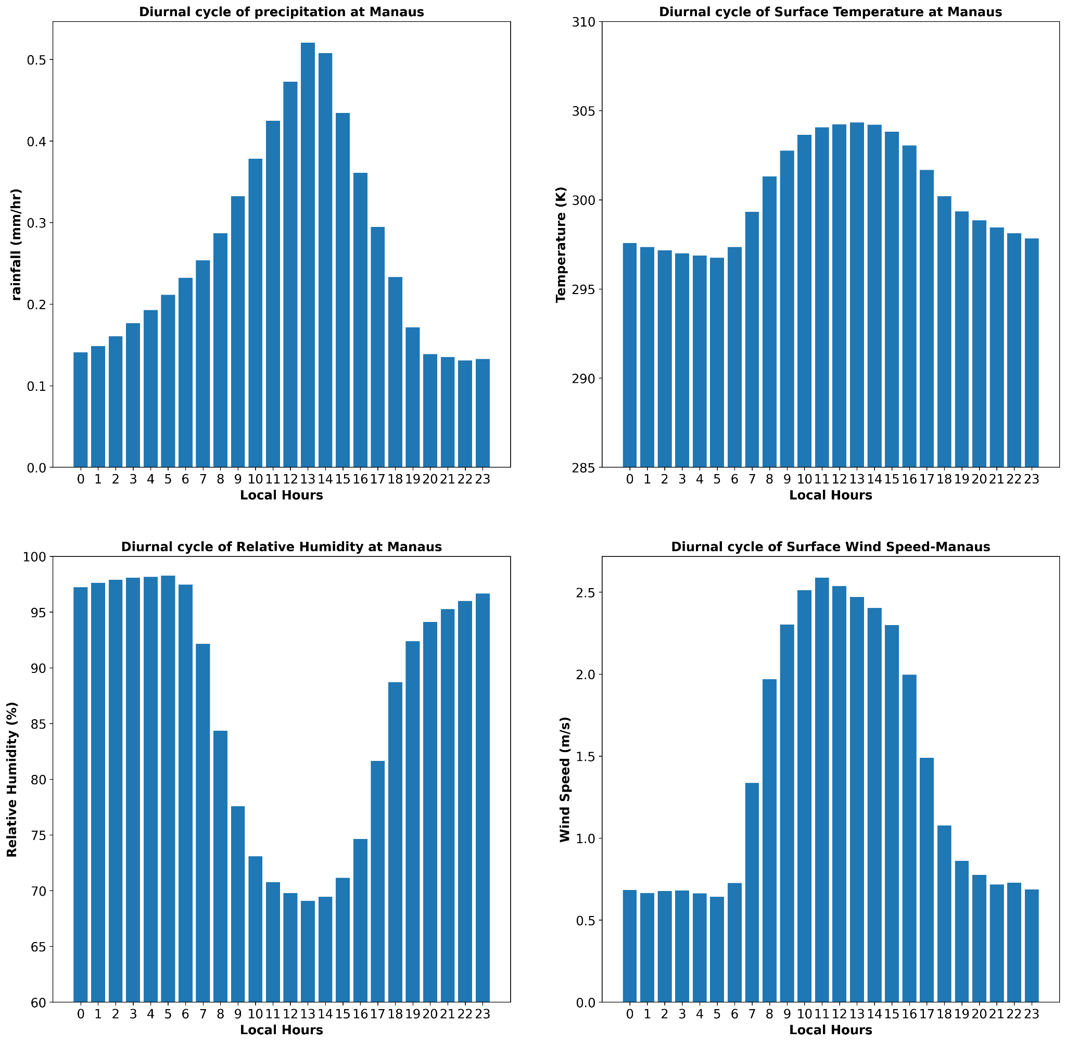
Diurnal Analysis - 2014/15
High precipitation rate during afternoon.
Warm air can hold more water vapor.
High Surface wind speed during noon.
Fig. Diurnal cycle of surface meteorology; precipitation, temperature, relative humidity, and wind speed.
Notes:
(300K − 273.15) × 9/5 + 32 = 80.33°F

Slide 7
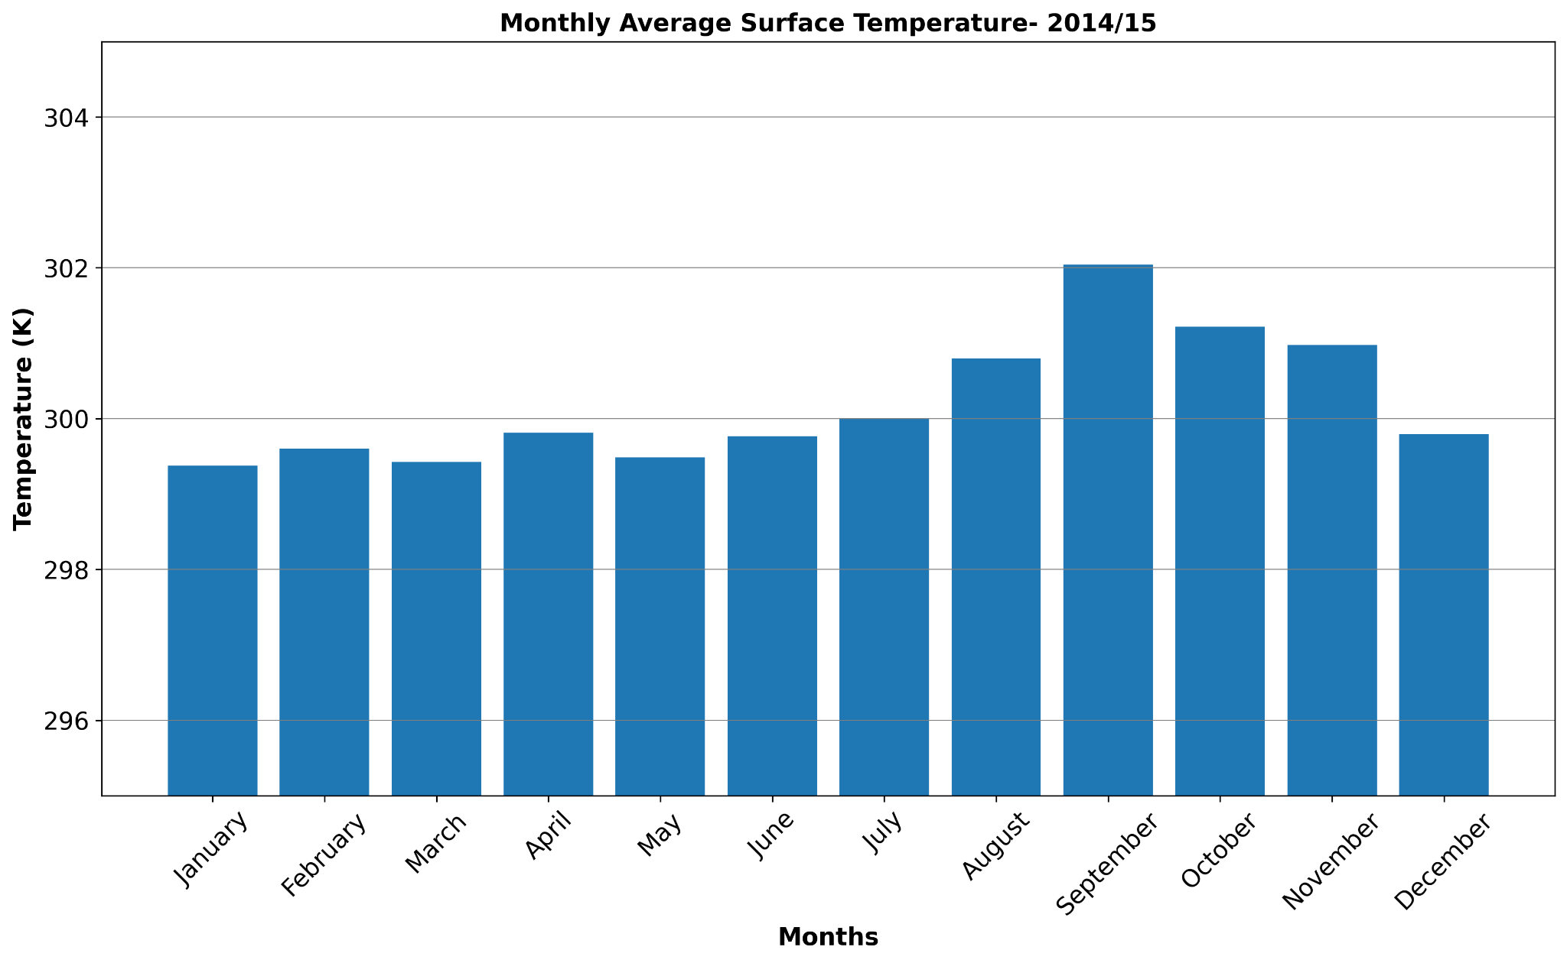
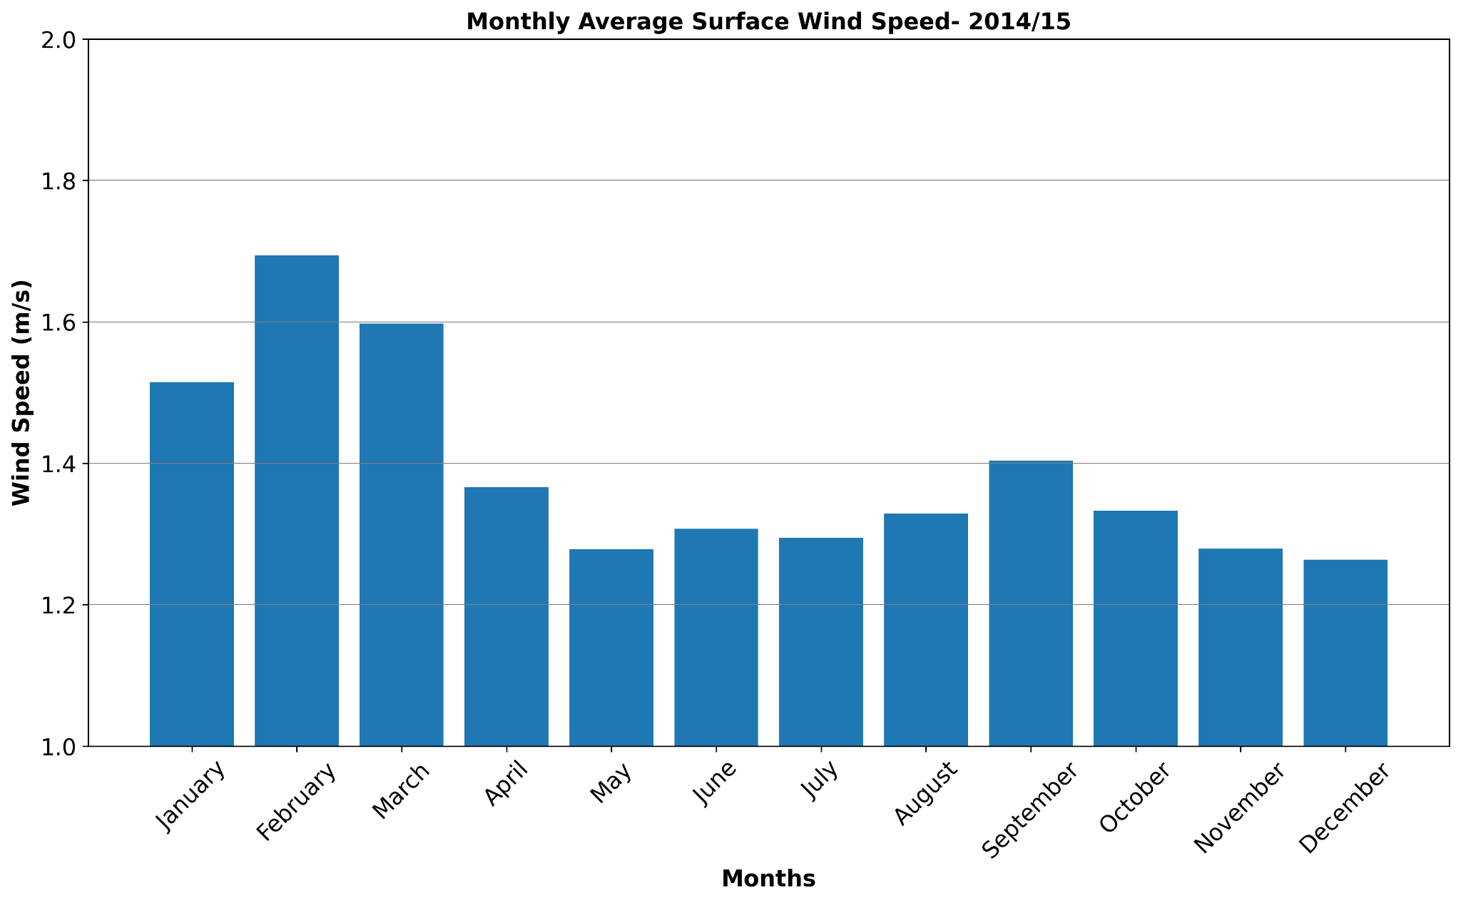
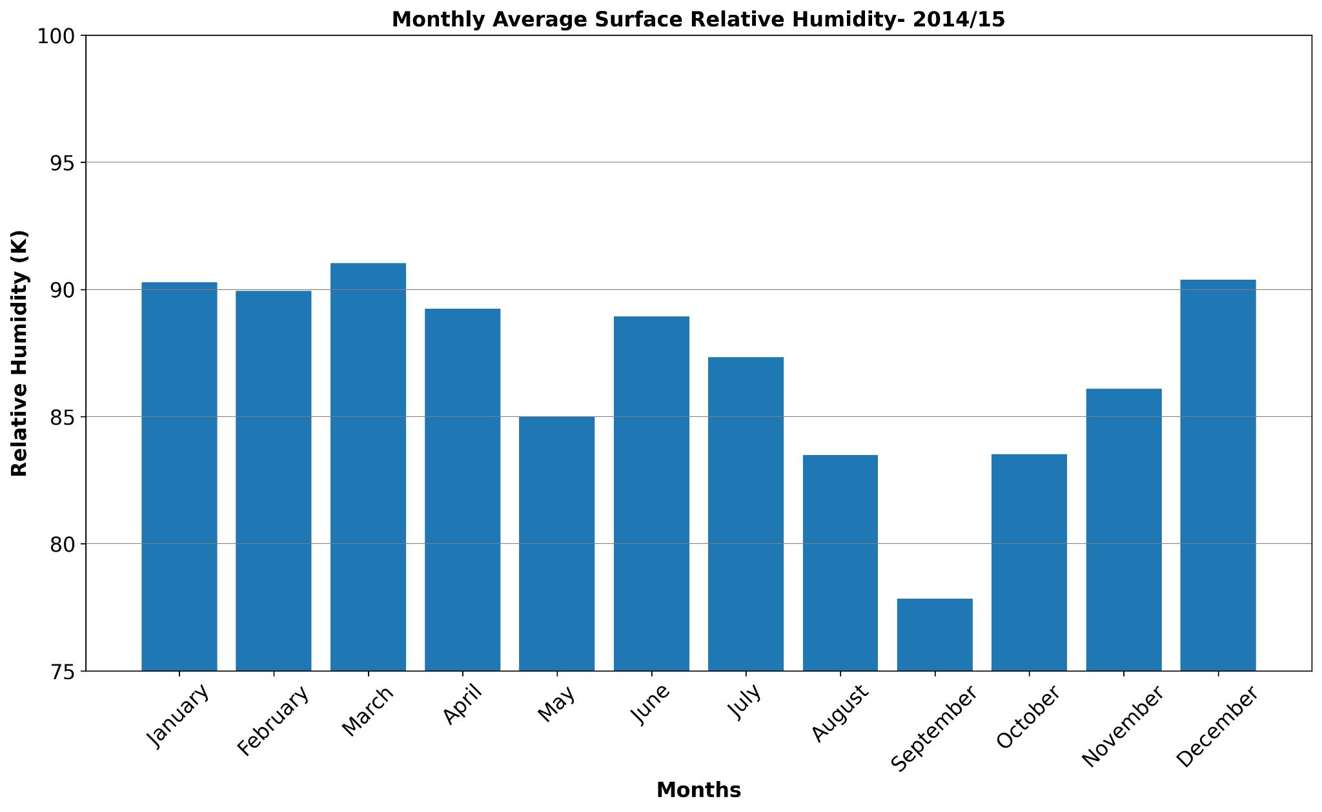
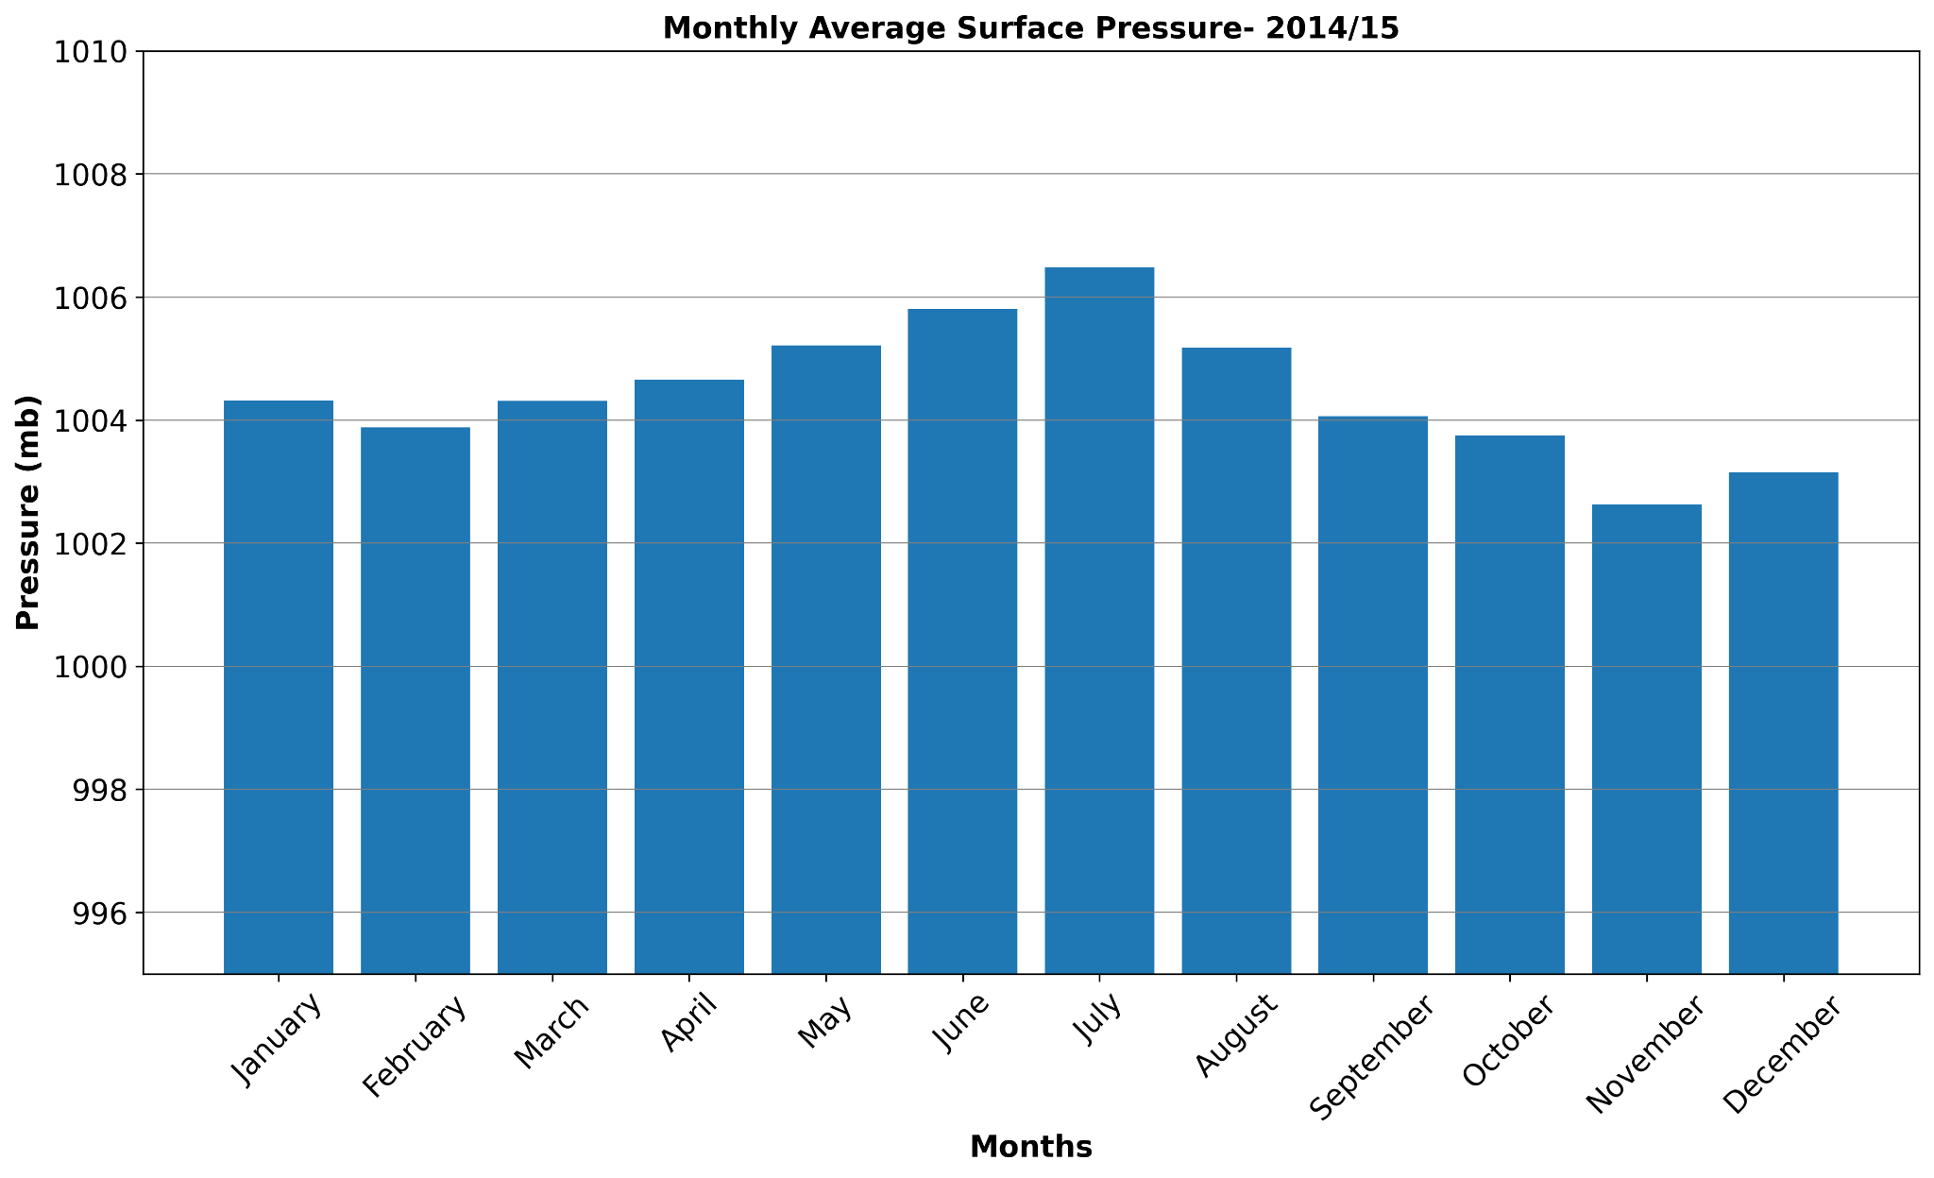
Surface Meteorology-2014/15
Notes:
Same temperature throughout the year. September has slightly high.
Wet season has slightly high surface wind speed.
RH is low on September.
Almost same surface pressure. July has high pressure, meaning low precipitation.

Slide 8
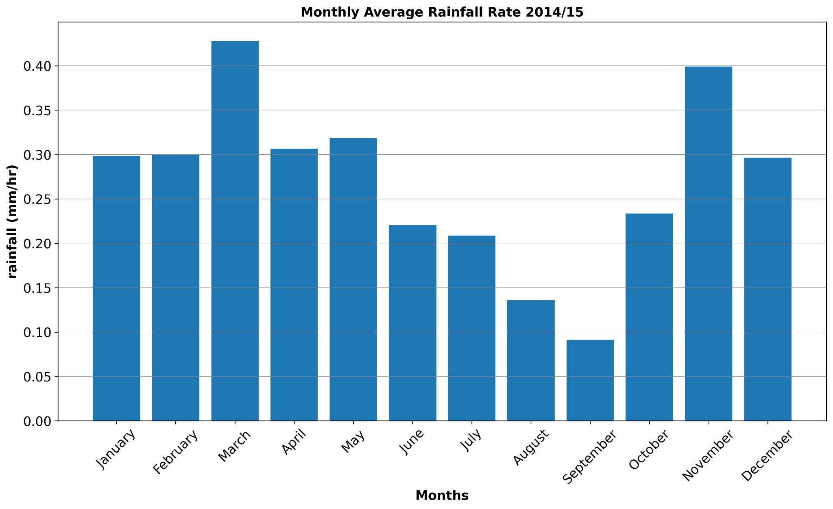
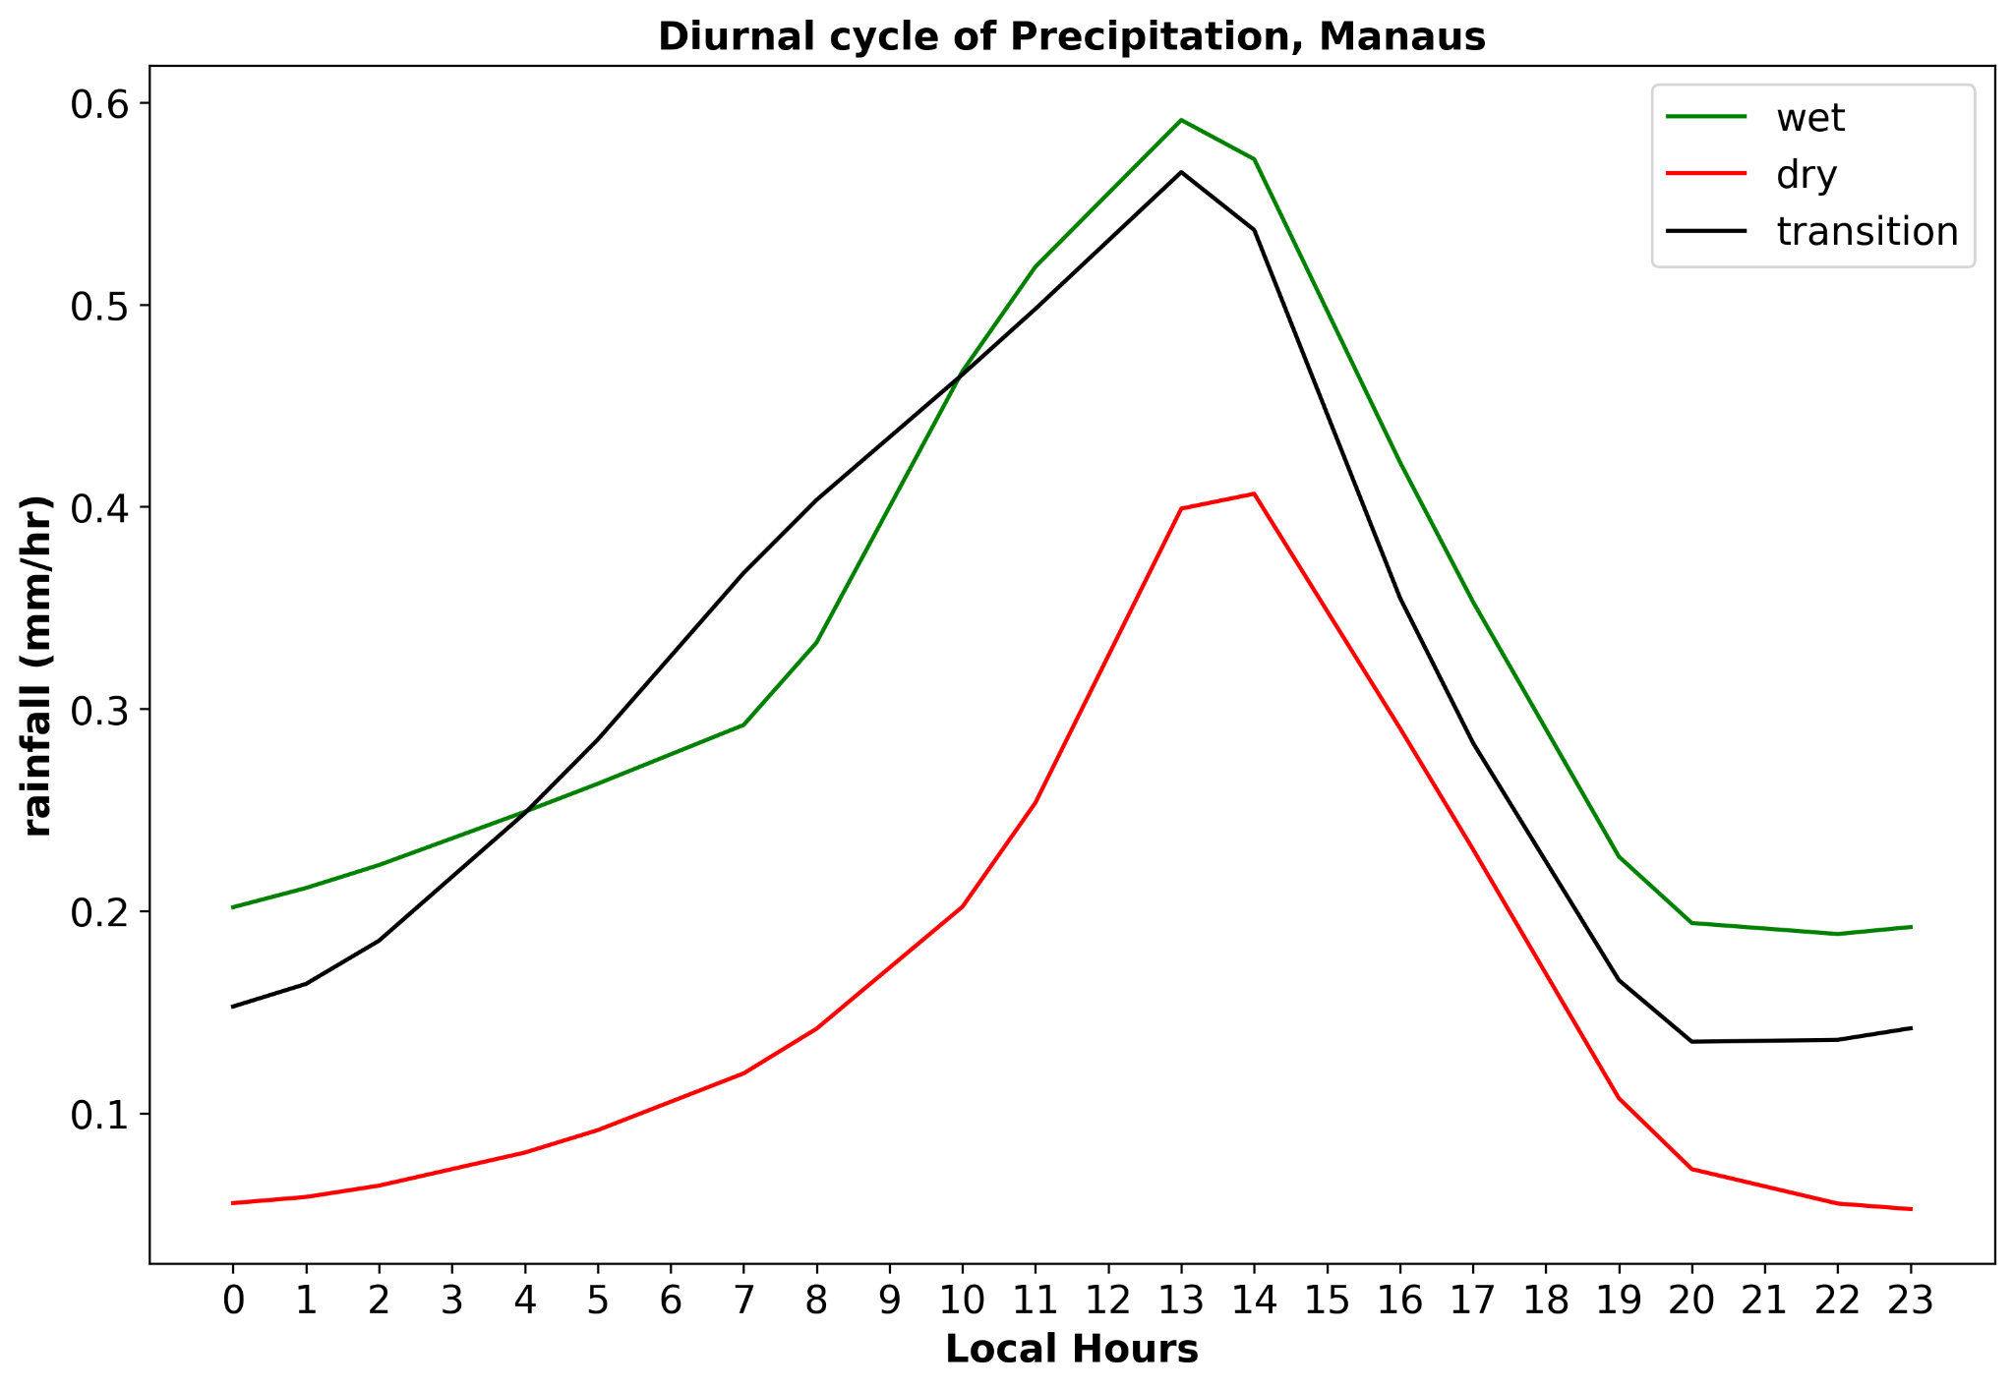
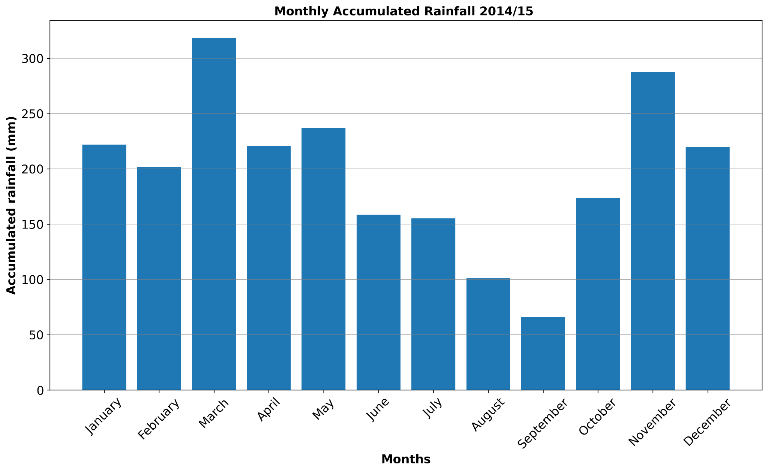
Precipitation Analysis for 2014/15
Comparatively high rainfall (intensity/cumulative) during wet seasons.
November (transition season) ?? -also shows high rainfall.
Wet Season: Jan-May
Dry Season: June-Sept
Transitional Season: Oct-Dec
Notes:
High precipitation rate in wet season, March. Low in September (Dry).
High precipitation in March, low in September.
More change of rain n wet seasons.
Can be seen from box plot.

Slide 9
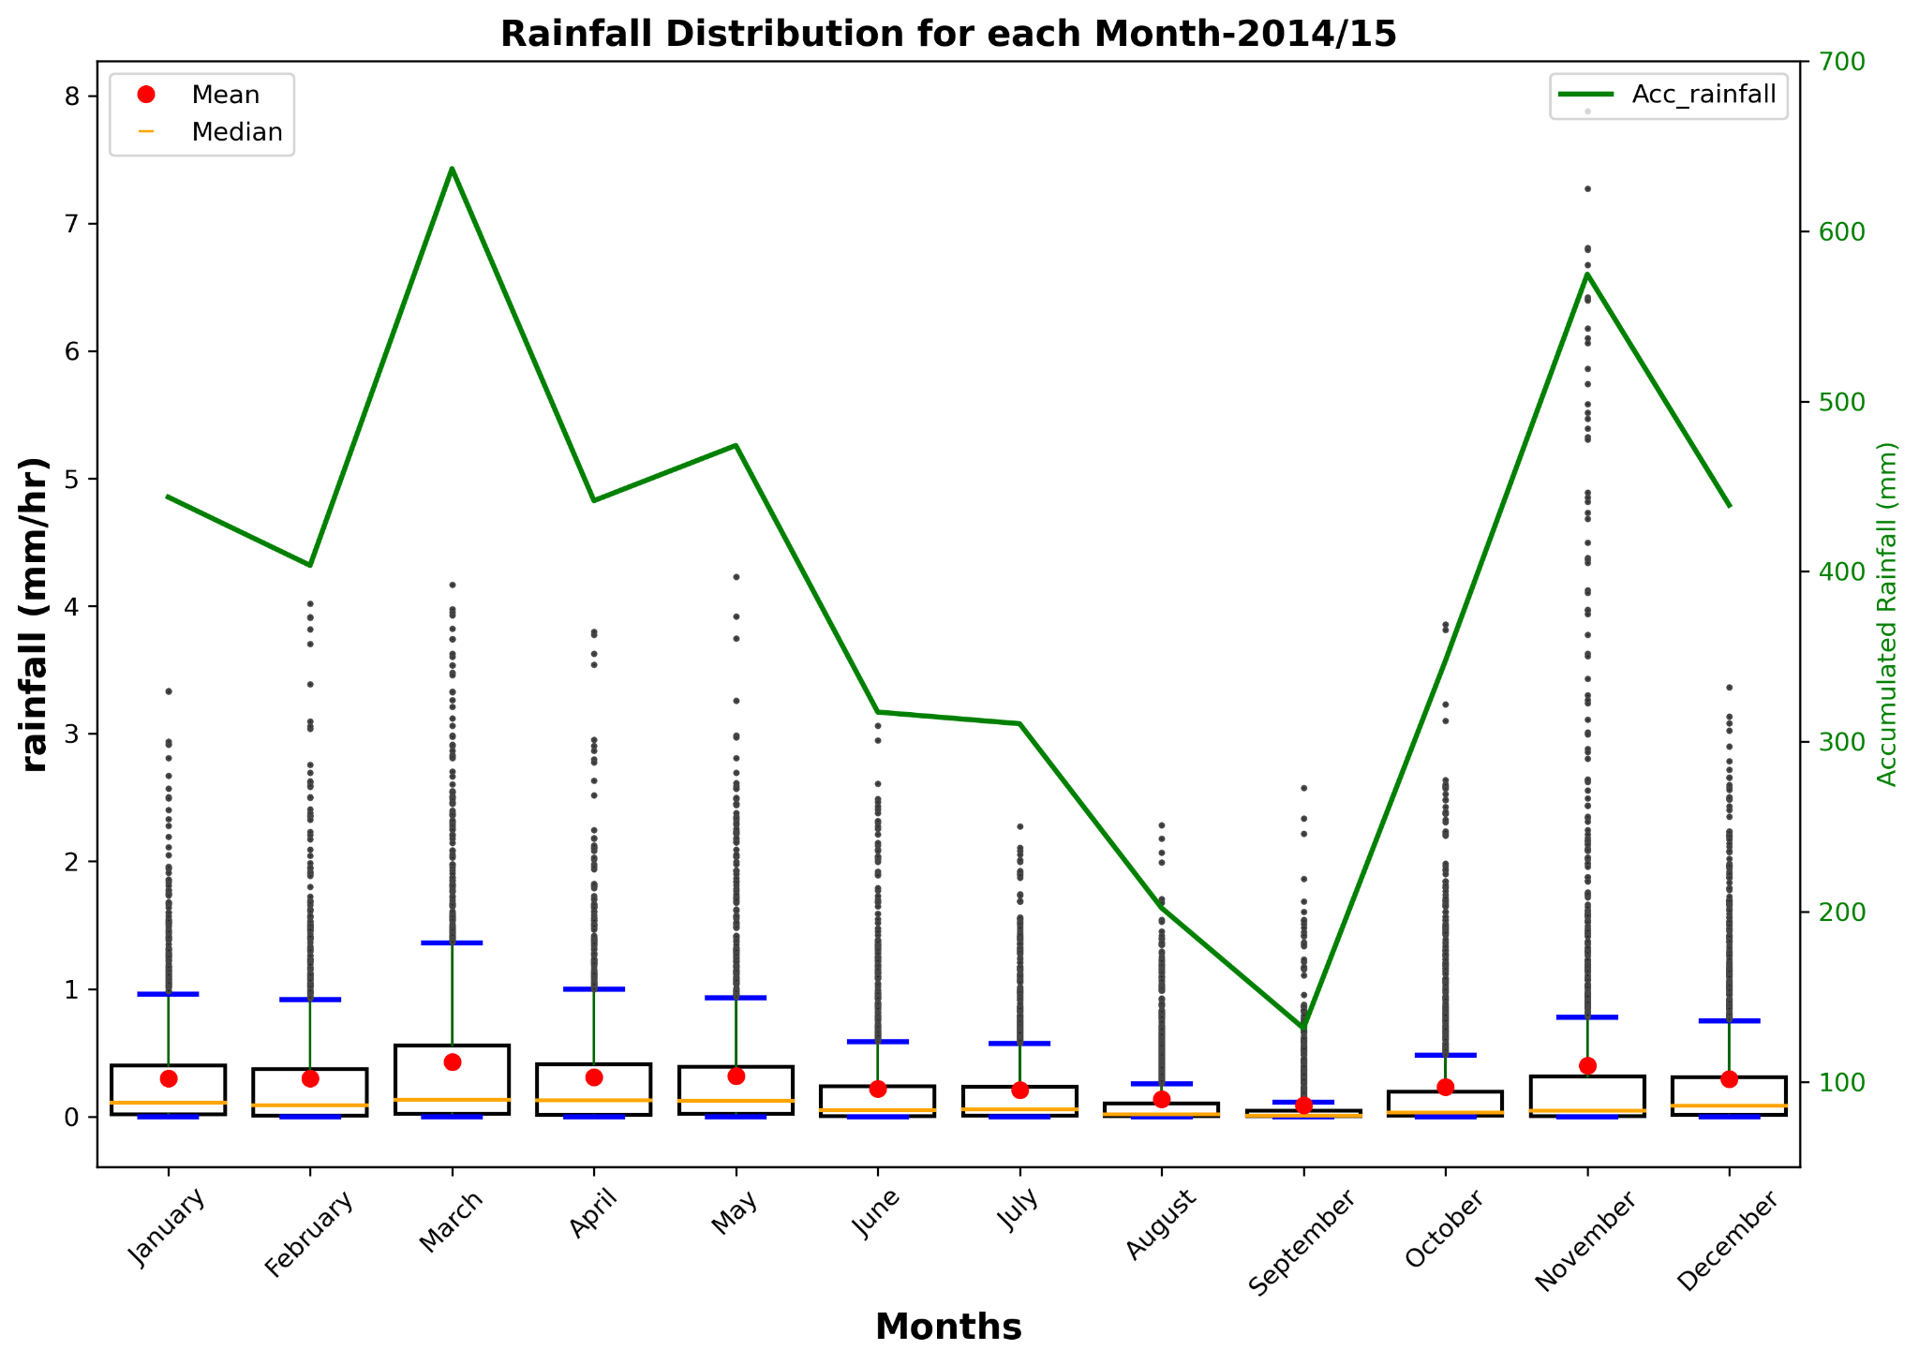
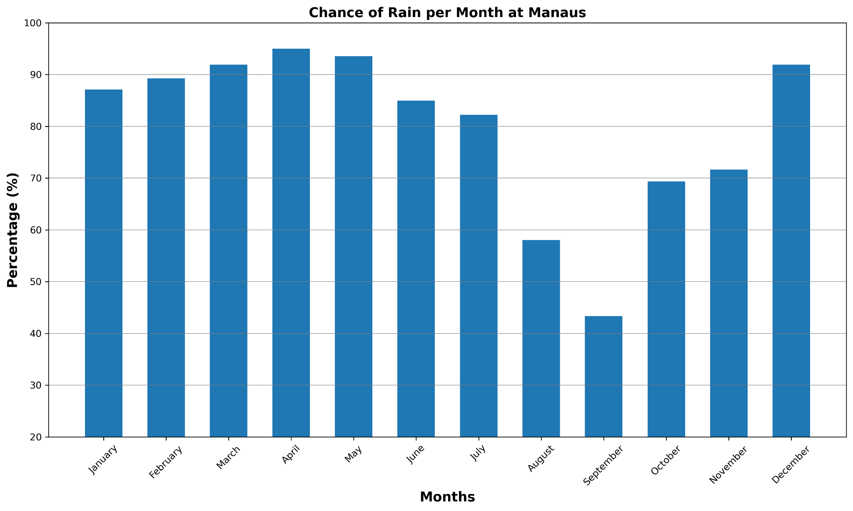
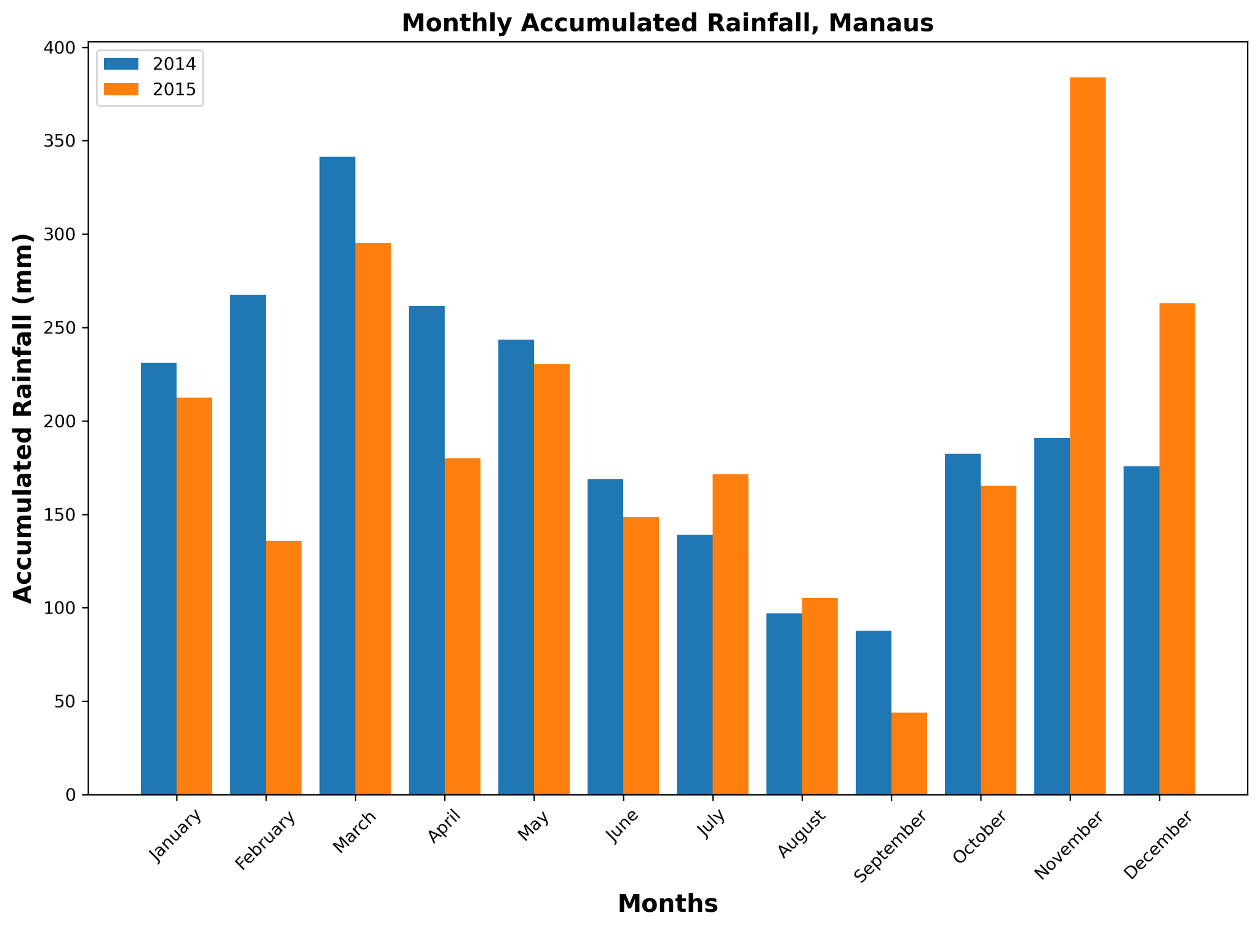
Precipitation Analysis for 2014/15
Wet season- high chance of rain.
(good for river cruise)
Dry season- low chance of rain.
(good for jungle tours)
November, 2015- high rainfall
(El Nino event)
Notes:
High precipitation rate in wet season, March. Low in September (Dry).
High precipitation in March, low in September.
More change of rain n wet seasons.
Can be seen from box plot.

Slide 10
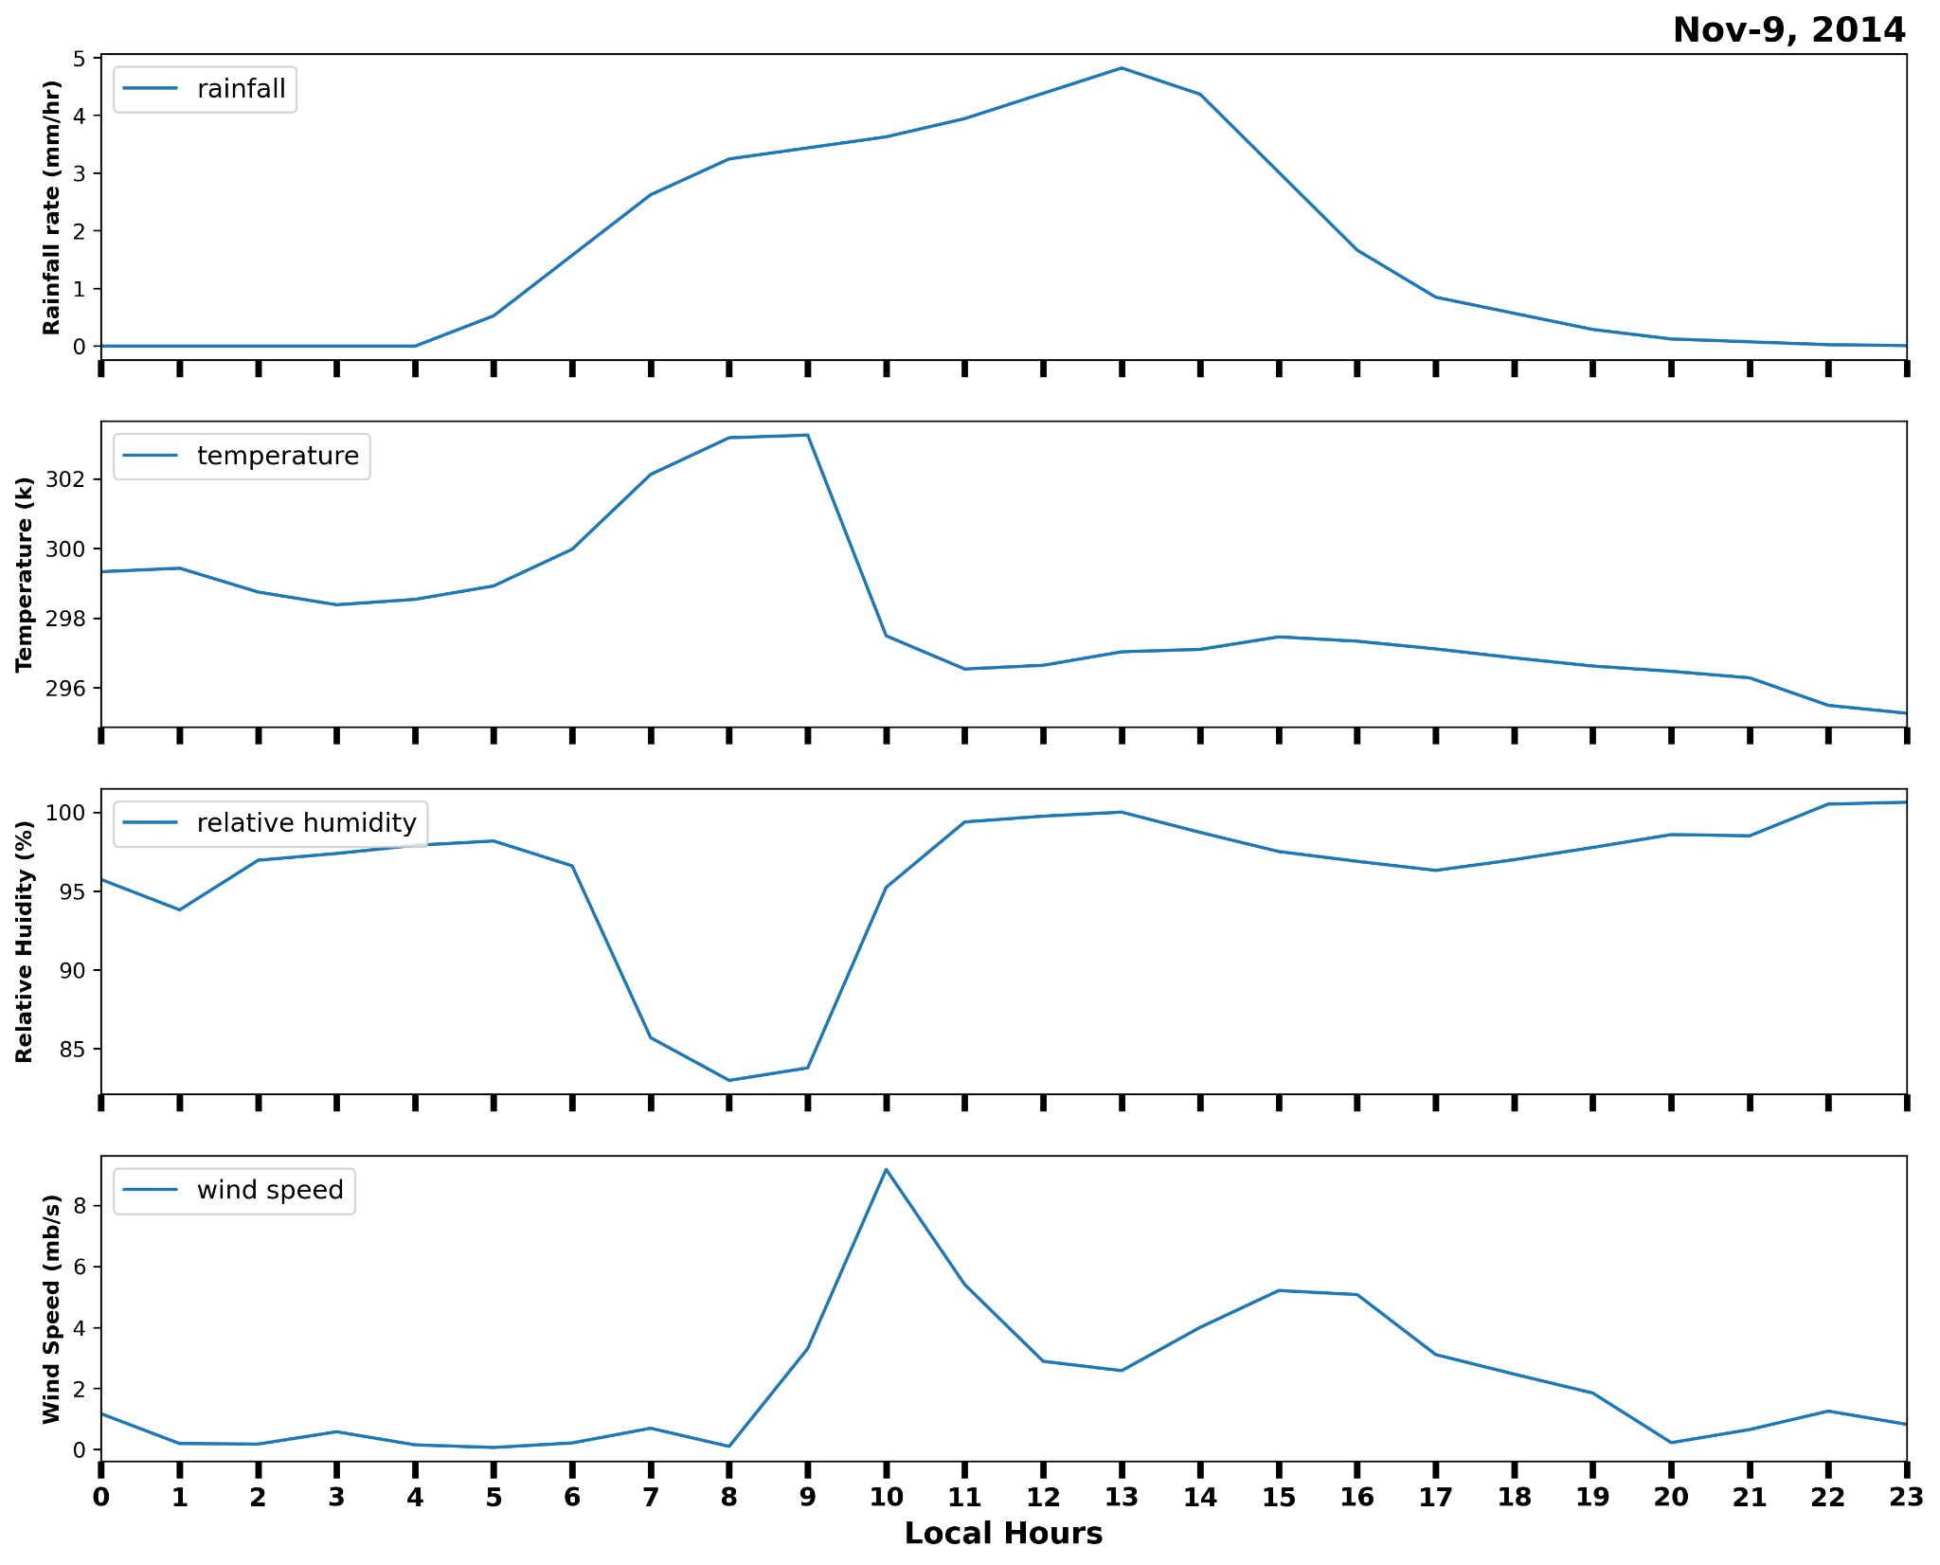
One Example of Convective event - November 9, 2014
During rainfall, surface temperature drops while relative humidity and surface wind speed increase.
Helpful to validate the climate and weather model.
Fig. Surface meteorology during convective event. Top to bottom: rainfall, temperature, relative humidity, and wind speed at Manaus.
Notes:
Advantage of model over observation?

Slide 11
Conclusions
The temperature is almost same for all year around (same weather).
Higher rainfall in wet season compared to others.
High rainfall on November, 2015 is related to El Nino event.
Lowered in surface temperature, and increase of relative humidity and wind speed during the thunderstorm.
Comments
Short period of data. Could be better if we have long time period data.
Quality of data: due to severe weather conditions, instrument malfunction, and calibration error, some data may have quality issues.
Notes:
Draw the results.

Slide 12
References
Giangrande, S. E., and Coauthors, 2017: Cloud characteristics, thermodynamic controls and radiative impacts during the Observations and Modeling of the Green Ocean Amazon (GoAmazon2014/5) experiment. Atmos. Chem. Phys., 17, 14 519–14 541, https://doi.org/10.5194/acp-17-14519-2017.
_____ D. Wang, and D. B. Mechem, 2020: Cloud regimes over the amazon basin: Perspectives from the GoAmazon2014/5 campaign. Atmos. Chem. Phys., 20, 7489–7507, https://doi.org/10.5194/acp-20-7489-2020.
https://www.arm.gov/
https://www.google.com/
Y. Zhuang, R. Fu, J. A. Marengo, and H. Wang. Seasonal variation of shallow-to-deep convection transition and its link to the environmental conditions over the Central Amazon: Shallow-to-Deep Convection Transition. Journal of Geophysical Research: Atmospheres, 122(5):2649–2666, Mar. 2017. ISSN 2169897X. doi: 10.1002/2016JD025993. URL http://doi.wiley.com/10.1002/2016JD025993.
Notes:
This can help to provide a more comprehensive understanding of the factors that influence the transition from shallow cumulus clouds to deep convective clouds across various environments.

Slide 13
Thank you !!!

